Slide 1
Centrifugal Pump FMD Lecture

Slide 2
Preface
Assumptions: Incompressible flow, time-averaged velocities, 2-D steady flow, constant fluid composition (density)
Reynolds Number Regime: Large Re (high flow rate low viscosity applications)
Actual Flow is 3-dimensional and unsteady, but this requires analysis which is too complex for our purposes, so this suffices
“Tangential” means the same thing as “circumferential” unless otherwise specified

Slide 3
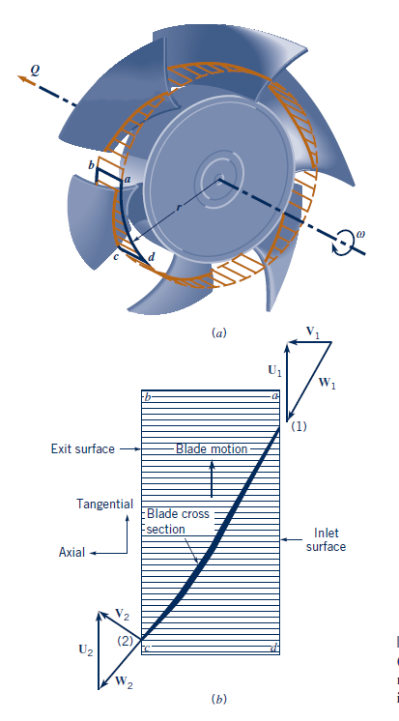
Axial Flow Pump
U = ⍵*r
W =
Citation: [4, p. 682]

Slide 4
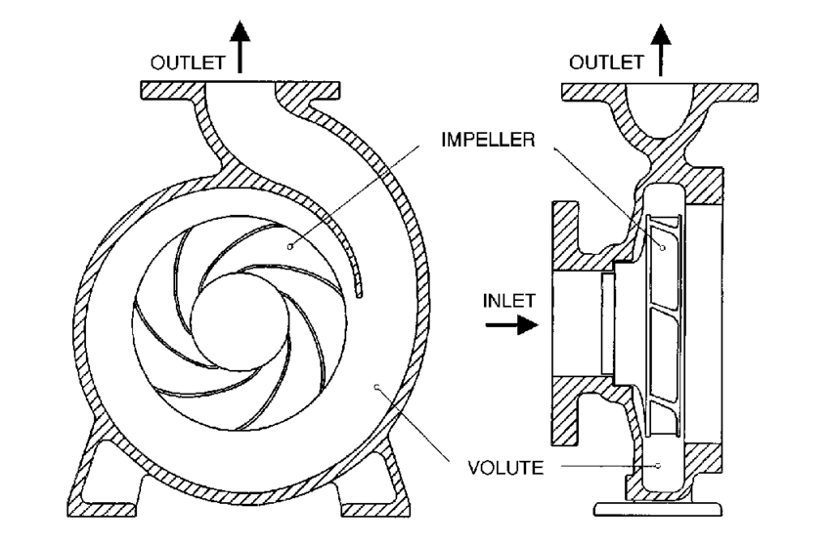
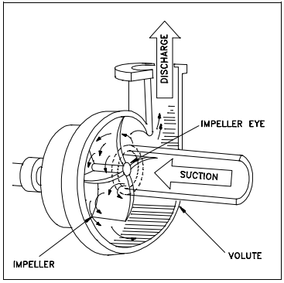
Centrifugal Pump components
Key Takeaway: Work added → increase fluid velocity → decelerate to produce P
VANES
Citations Left to Right: [3, p. 199], [1, p. ME-03 2]
Notes:
Centrifugal pumps consist of three main parts: the impeller, the vanes, and the volute casing. The main point of these pumps is that the impeller does work on the fluid to increase its velocity and then the casing trades this velocity for pressure

Slide 5
Volute Shape
Key Takeaway: Increase area to increase pressure via Bernoulli
Curved design ensures that velocity distribution is essentially uniform by reducing flow disturbances
By Bernoulli’s Equation: B = P₁ + ½𝜌U₁² = P₂ + ½𝜌U₂²
By conservation of Mass: Q = U₁A₁ = U₂A₂
Using a streamline from the eye inlet, through the impeller, and to the outlet, Increasing the downstream area A2 leads to a decrease in velocity U2, this leads to an increase in pressure P2 by the time the fluid has reached the outlet.
This increase in area is also seen in the impeller vanes’ channels
A2
A1
Citation: [3, p. 199]
Notes:
As you can see from the diagram, the cross sectional area of the volute casing increases. For this analysis we will consider a streamline from the eye of the impeller to the exit of the pump, as shown in blue. By conservation of mass for an incompressible fluid, the fluid’s velocity decreases, and by Bernoulli, the fluid pressure rises.

Slide 6
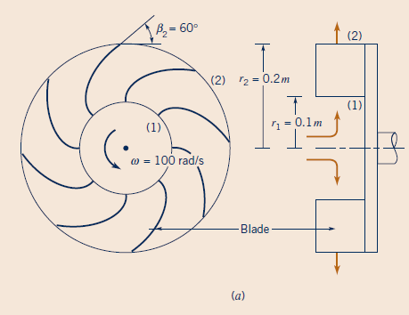
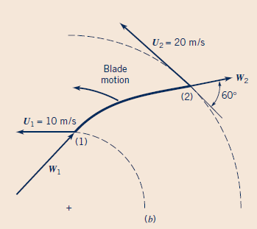
Velocity Diagrams
V1
r
V1
At the design speed the relative velocity vector W is approx. tangent to the vanes @ inlet & exit
At the design conditions the flow is approx. smooth
Citation: [4, p. 684]

Slide 7
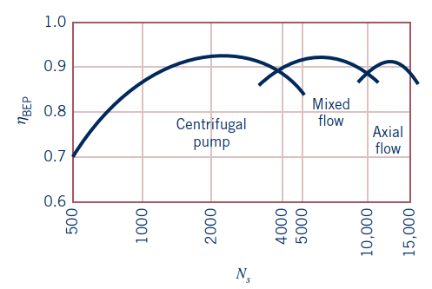

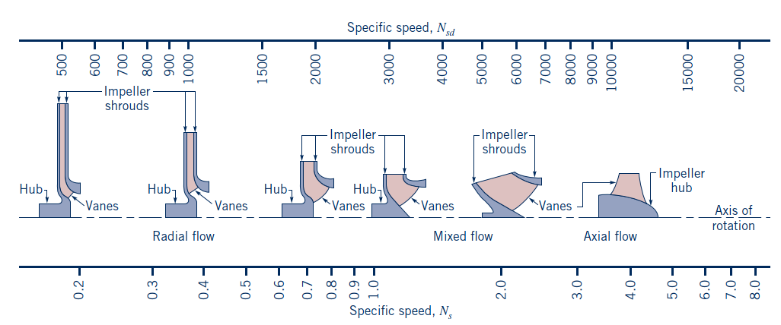
Selection Between Rotodynamic Pumps
Specific speed is a pseudo dimensionless measure of pump performance for all rotodynamic pumps
Centrifugal pumps have the lowest specific speeds
Have the highest heads and lowest flow rates
Citations Left to Right: [4, p. 704], [4, p. 682]

Slide 8
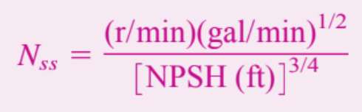
Net Positive Suction Head (NPSH)
NPSH is used to determine if cavitation will occur
Cavitation is boiling of the fluid being pumped
Formula for NPSH
NPSH = P_{inlet}/γ + V_{inlet}²/2g - P_{vapor}/γ
Experimental results show that pumps with Nss>8100 have risk of cavitation

Slide 9
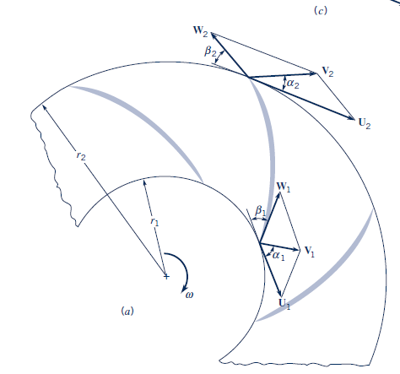
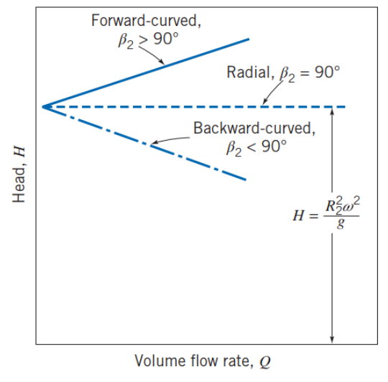
Impeller Vane Orientation & Shape
Key Takeaway: Backward vanes’ geometry allows for steadiest, most stable fluid flow @ expense of lower outlet velocity → most desireable for overall performance
Swirl: When there is a circumferential component of the inlet absolute velocity therefore our assumptions fail
Unstable, may cause pump surge
Citations Left to Right: [5, p. 429], [4, p. 689]

Slide 10
Suction at Inlet Explained by Bernoulli’s Eqn
Bernoulli’s eqn with grav. PE neglected - B = P₁ + ½𝜌U₁² = P₂ + ½𝜌U₂²
We can draw a streamline between some point of the fluid in the inlet pipe outside of the eye, and some point inside the impeller itself
Fluid in pump is faster than fluid flowing at inlet since it is being accelerated by the impeller vanes, therefore U₁ < U₂
Because of the difference in velocities, it must be the case that P₂ < P₁ by Bernoulli’s Eq
Pressure gradient between inlet and impeller causes higher pressure fluid to flow into the pump

Slide 11
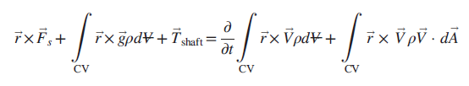



Euler’s Turbomachinery Principles
Use a Finite control volume enclosing the rotor vanes
Apply the angular momentum conservation equation for a finite control volume:
Cross out terms for steady flow, Tshaft >> r x Fs, & no net gravitational force torque
Assuming that the inlet/outlet flow is uniform out from the eye, we integrate over the area of the circumferential wall of our C.V about of the impeller:
Dot product angular velocity with both sides to get power, & since U = ⍵*r this simplifies to:
Sign Convention: Ẇ_{m}, T_{shaft} > 0 (pumps) Ẇ_{m}, T_{shaft} < 0 (turbines) V_{t} > 0 (if same direction as U)
Negligible
Symmetry
Steady
“t” denotes tangential component WRT axis of rotation
r denotes position of fluid element WRT axis of rotation
Citation: [5, p. 417–419]

Slide 12
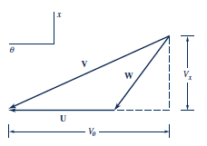


Euler’s Turbomachinery Principles
Key Takeaway: Cons. angular momentum on impeller C.V. → simplify w/ assumptions → relates shaft torque w/ inlet/outlet conditions → power requirement
From basic vector addition it can be shown that:
Plugging this into our Euler Turbomachinery Eq we get a convenient form:
“w” is the power normalized by the mass flow rate
These Eqs can be applied to any turbomachine, & represent the upper limit for performance b/ of our underlying assumptions.
t
Citation: [4, p. 686]
Notes:
Euler’s Turbomachinery equation relates the inlet and outlet fluid velocities to the angular velocity of the turbomachine. It can be applied to any piece of turbomachinery for example a pump that does work on a fluid to increase the enthalpy, or a turbine that uses the enthalpy of the fluid to do work.

Slide 13

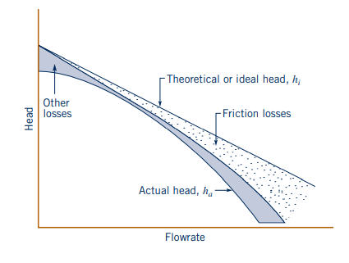

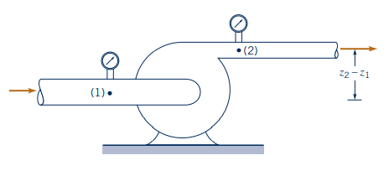

Pump Performance (The Result)
Taking our equation for head H, assume inlet flow is purely radial, therefore Vt1 = 0
Ideal head of a centrifugal pump can then be expressed as , derived from the velocity components at the exit and the flow rate equation, , where it is shown that the ideal head varies linearly with flow-rate for a given pump geometry.
However, due to viscous losses, which vary with Q^2, and other losses, such as fluid separation and other complex fluid effects, the actual head varies neither with Q or Q^2, but varies within the system itself.
Due to this complexity, to find the actual head, an experimental setup is needed, which produces the equation
,
which is derived from the Bernoulli equation on a head basis, as actual head is equal to the difference between shaft work head and head losses.
Citation: [4, p. 690–695]
Notes:
The pump performance curve can be thought of as a torque rpm curve for an electric motor. As flowrate/rpm increases, head/torque decreases. The shutoff head is the pressure generated with zero flow-rate. This is analogous to the stall torque of a motor.

Slide 14
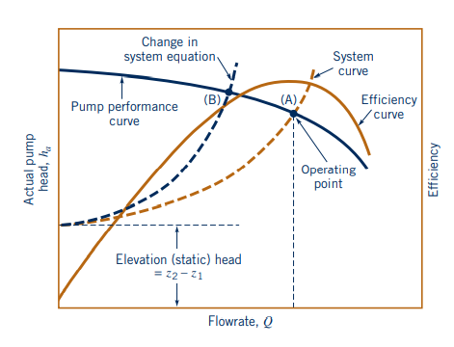




Pipe and Pump Performance Curves
Key Takeaway: combine theoretical eqs w/ empirical data to plot useful contours for selection
To find the operating point for a pump, one must use both the system pipe performance curve and the pump performance curve. Their intersection, the operating point is when the flowrate and head satisfy both the system and the pump equations
To find the best pump for a specific application, we must find a pump where the operating point is near the peak of the efficiency curve. In this graph, point A would be a fantastic operating point for the system, whereas point B would be a less than ideal operating point.
System Pipe Performance:
Pump Performance (experimental setup):
Pump Efficiency Curve:
Citations: [4, p. 692–697], [5, p. 433]
Notes:
However, due to the general complexity of flow through a centrifugal pump, the actual performance of the pump cannot be accurately predicted on a completely theoretical basis as indicated by the data of Fig. 12.9. Actual pump performance is determined experimentally through tests on the pump. From these tests, pump characteristics are determined and presented as pump performance curves. It is this information that is most helpful to the engineer responsible for incorporating pumps into a given flow system. The efficiency of a pump increases with flowrate up to a point, the best efficiency point (BEP). At the BEP, radial forces and vibrations are minimized, which causes the high efficiency.

Slide 15
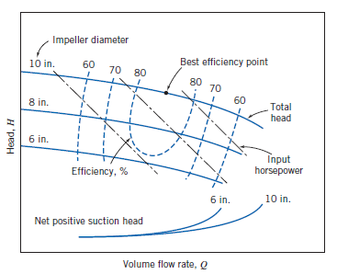
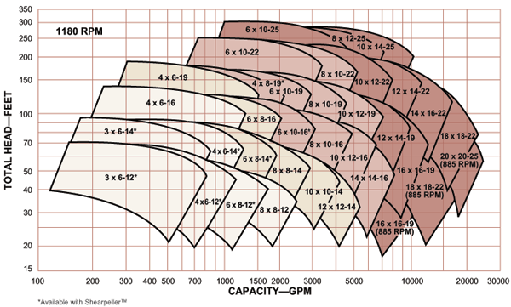
Key Takeaway: Use eqs for general trends → gather empirical data to account for complex losses → plot data using efficiency contours → pick a general pump in hydraulic coverage → choose best impeller diameter for your system (pipe)
Pump Performance Chart, Efficiency = f(H,Q)
Hydraulic Coverage Chart
Citations Left to Right: [2], [5, p. 437]

Slide 16
Net Positive Suction Head (NPSH)
Used as a factor to determine whether or not cavitation occurs
Cavitation - Occurs when the pressure of the fluid equals the vapor pressure of the fluid
Causes fluid to “boil” and can greatly reduce pump efficiency and cause damage
Formula for NPSH
NPSH = P_{inlet}/γ + V_{inlet}²/2g - P_{vapor}/γ
Notes:
One of the major considerations when selecting a pump is whether or not cavitation will occur. Cavitation occurs when the static pressure of a fluid equals its vapor pressure. This usually occurs at the inlet, which is the area of lowest static pressure. Cavitation is when the fluid starts to boil and form pockets of vapor. When these pockets collapse, they can damage the impeller vanes. In addition, the onset of cavitation greatly decreases the performance of a pump. Net Positive Suction Head is the difference between the stagnation pressure of the fluid and the vapor pressure of the fluid. It is sort of like factor of safety.

Slide 17
Works Cited
[1] DOE-HDBK-1018/1-93., vol. 1. United States. Dept. of Energy. Office of Scientific and Technical Information, 1996
[2] “Goulds 3180 Heavy Duty Process Pump - Industrial Fluid Consultants Inc.” https://www.ifcpump.com/product/goulds-3180 (accessed Nov. 26, 2022).
[3] J. Parrondo, S. Velarde-Suárez, and C. Santolaria, “Development of a Predictive Maintenance System for a Centrifugal Pump,” Journal of Quality in Maintenance Engineering, vol. 4, pp. 198–211, Sep. 1998, doi: 10.1108/13552519810223490.
[4] P. M. Gerhart, A. L. Gerhart, and J. I. Hochstein, Munson, Young and Okiishi’s Fundamentals of Fluid Mechanics, 8th ed. Wiley, 2015.
[5] R. W. Fox, A. T. McDonald, P. J. Pritchard, and J. W. Mitchell, Fox and Mcdonald’s Introduction to Fluid Mechanics, 9th ed. Hoboken, NJ: Wiley, 2015.

